Slide 1
LG 1.)
“Explain the case of Marbury v Madison and the principle of Judicial Review”

Slide 2
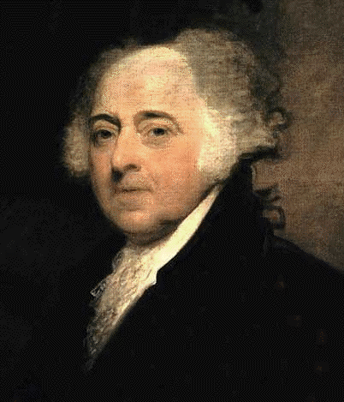
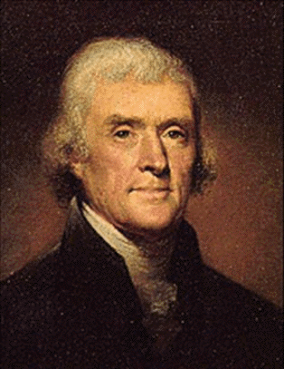
The Election of 1800
vs.
John Adams
Party: (Federalist)
(incumbent)
Thomas Jefferson
Party: (Democratic-Republican)

Slide 3
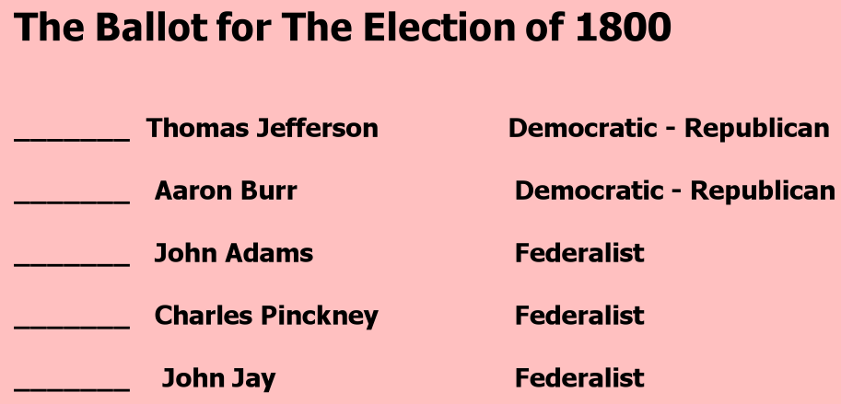
Who wins?
275 total electors
(129 from Federalist states, 146 from DR)
* Each “elector” had 2 votes for President.

Slide 4
There was a tie in the Election of 1800 between Thomas Jefferson and Aaron Burr.
The Democratic-Republicans intended to elect Jefferson as President and Burr as VP, so one elector was to withhold the Electoral Vote for Burr to ensure he came in second place.
However one elector mistakenly voted for both candidates; this resulted in a tie.
Per the Constitution, the House of Representatives chooses the President in the event of a tie. The House chooses Thomas Jefferson.

Slide 5
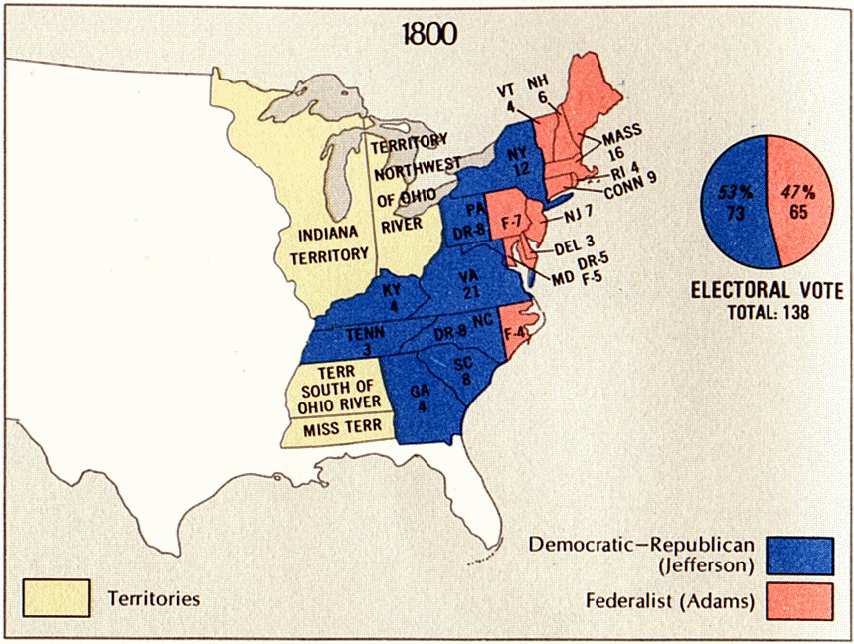

Slide 6
Significance of 1800 election?
Showed huge flaw in election process – there was tie! (Why not have people run as a “pair”, 1 President and 1 Vice President?)
The 12th amendment was ratified in 1804 which allowed for the election of Pres and Vice Pres on separate ballots.
Very peaceful transfer of power from Federalists to Democratic-Republicans – most European power-transfers were violent and bloody

Slide 7
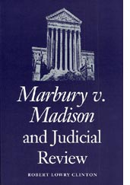
1800
John Adams (President)
John Marshall (Secretary of State)
William Marbury (Appointed Judge)
1803
Thomas Jefferson (President)
James Madison (Secretary of State)
John Marshall (Chief Justice of the
Supreme Court)

Slide 8
Marbury v. Madison (1803)
- In the Election of 1800, Thomas Jefferson defeated John Adams
Jefferson wins election in November 1800 but inauguration day isn’t until March 4, 1801.
Adams is still in office for 4 months until Jefferson takes over.
- Lame Duck Period – the time period before a new elected official, since the old one isn’t likely to do anything (like a “lame duck.”)

Slide 9
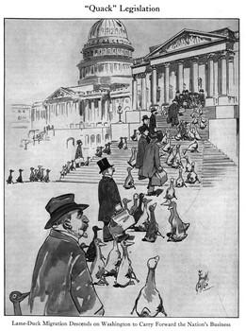

Slide 12
What sort of things might a President do during the “lame duck” period, since he knows he is leaving anyway?
How does a President (or a member of Congress) become a “lame duck”?

Slide 13
Marbury v. Madison (1803)
During Adams’ “lame duck” period, he appoints several
Federalist justices to the court system
It was the duty of Adams’ Secretary of State, John Marshall,
to deliver the “commission” (a document granting authority
to do a job) to each new appointee.
Marshall doesn’t deliver them all before Jefferson took over as President! One of these men who didn’t receive his commission was William Marbury…

Slide 14
Marbury v. Madison (1803)
When Jefferson takes over, he refuses to finish appointing these “Midnight” Federalist judges. He wants to appoint people that
he wants as judges!
James Madison (Jefferson’s Secretary of State) walks into his office on his first day and sees several undelivered commissions on his desk.
What do you suppose Jefferson tells Madison to do with them?
- Secretary of State, James Madison, is told not to deliver the commission papers to the remaining Federalist judges.
William Marbury (judge appointed under Adams) sues James Madison (Secretary of State under Jefferson). Marbury says Madison must deliver the commission. John Marshall is now the Chief Justice of the Supreme Court.

Slide 15
Marbury v. Madison (1803)
The case goes to the Supreme Court – what do they say?
1.) Madison can deliver the commission but cannot be required to. Jefferson is free to choose his own judge.
2.) Judicial Review - the power for the court to review acts of other branches to determine whether they are constitutional or not.

Slide 16
Marbury v. Madison Video

Slide 17
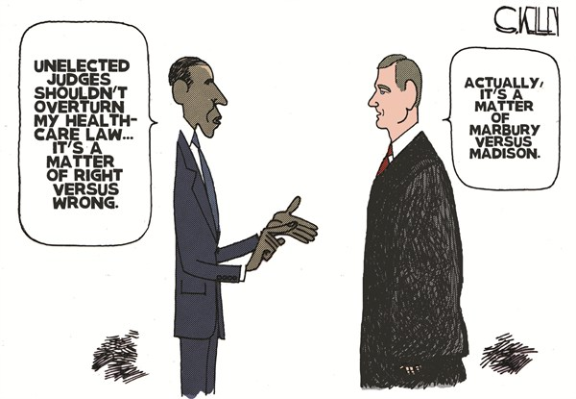
Read closely…can you explain it?

